Slide 1


Software Engineering
Spring’25
FAST-NU
Notes:
NOTE:
To change the image on this slide, select the picture and delete it. Then click the Pictures icon in the placeholder to insert your own image.

Slide 2

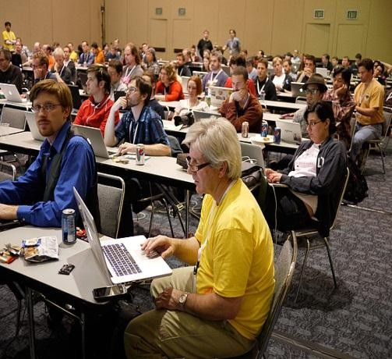
Prototyping Model
A customer defines a set of general objectives for software but does not identify detailed input, processing, or output requirements
The developer may be unsure of the efficiency of an algorithm, the adaptability of an operating system

Slide 3

Prototyping Model
This model adds prototyping as sub-process
A prototype is a partially developed product that enables customers and developers to examine some aspect of a proposed system and decide if it is suitable for a finished product

Slide 4
Prototyping Model
Used to explore the risky aspects of the system
Risk of developing the “wrong” system
User interface without functionality
Technical risks
Prototype may be thrown away or evolve into product

Slide 5
Software Prototyping
Software prototyping makes the requirements more real and closes gaps in understanding of the requirements
Prototyping puts a mock-up of a new system
Early feedback on prototypes helps the stakeholders arrive at a shared understanding of the system’s requirements

Slide 6
Prototyping - Major Purposes
Clarify and complete the requirements:
Used as a requirements tool, the prototype is a preliminary implementation of a part of the system that’s not well understood
User evaluation of the prototype points out problems with the requirements, which you can correct at low cost before you construct the actual product

Slide 7
Prototyping - Major Purposes
Explore design alternatives:
A prototype lets stakeholders explore different user interaction techniques, optimize system usability, and evaluate potential technical approaches
Prototypes can demonstrate requirements feasibility through working designs

Slide 8
Prototyping - Major Purposes
Grow into the ultimate product:
- A prototype is a functional implementation of an initial subset of the product, which can be elaborated into the complete product through a sequence of small-scale development cycles

Slide 9
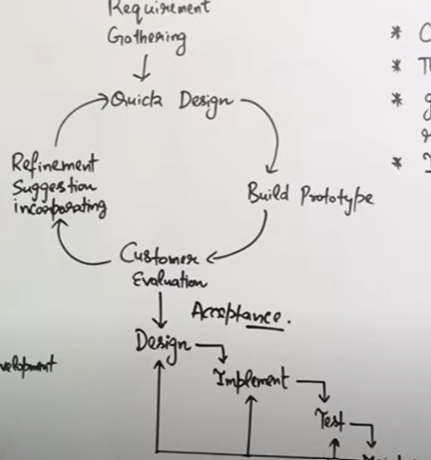

Slide 10
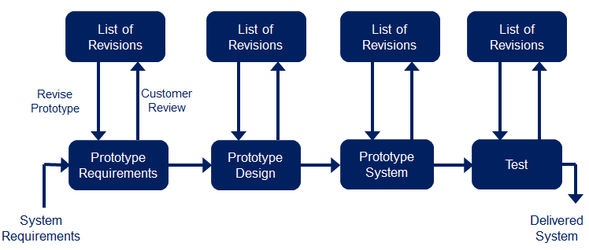
Prototyping Model (Pros)
Suitable for large systems for which there is no manual process to define the requirements
Much feedback from customer
Quality of software is good

Slide 11
Prototyping Model (Cons)
It may be impossible to tune the prototype to meet non- functional requirements
Lot of time at customer
The changes made during prototype development will probably have degraded the system structure

Slide 12
Horizontal Prototypes
Also called behavioral prototype or mock-up
It doesn’t dive into all the layers of an architecture or into system details but depicts a portion of the user interface
This type of prototype lets you explore some specific behaviors of the intended system, with the goal of refining the requirements
Notes:
Example: A mobile app UI mockup showing screens and buttons without actual backend processing.

Slide 13
Vertical Prototypes
Also known as Structural Prototype
It implements a slice of application functionality from the user interface through the technical services layers
A vertical prototype works like the real system is supposed to work because it touches on all levels of the system implementation
Notes:
Example: A payment system where a user can enter card details and complete a transaction, but the rest of the app isn't functional.

Slide 14
Throwaway Prototypes
Build a throwaway prototype (or exploratory/rapid prototype) to answer questions, resolve uncertainties, and improve requirements quality
Throwaway prototype emphasizes quick implementation and modification over robustness, reliability, performance, and long- term maintainability
Notes:
Example: A quick website mockup for a client, which is later replaced by the actual system.

Slide 15
Throwaway Prototypes
The throwaway prototype is most appropriate when the team faces uncertainty, ambiguity, incompleteness, or vagueness in the requirements
A prototype that helps users and developers visualize how the requirements might be implemented can reveal gaps in the requirements

Slide 16
Evolutionary Prototypes
An evolutionary prototype provides a solid architectural foundation for building the product incrementally as the requirements become clear over time
Evolutionary prototyping is a component of the spiral software development life cycle model and of some object-oriented software development processes
Notes:
Example: A social media app starting with just user profiles and messaging, later adding features like stories and video calls.

Slide 17
Evolutionary Prototypes
In contrast to the quick-and-dirty nature of throwaway prototyping, an evolutionary prototype must be built with robust, production-quality code from the outset
An evolutionary prototype must be designed for easy growth and frequent enhancement, so developers must emphasize software architecture and solid design principles

Slide 18
Prototypes
Gather User Requirements
Refine user requirements
Begin next increment
Develop throwaway horizontal prototype
Construct evolutionary prototype
Construct vertical prototype
Design User Interface
Verify and deliver
increments
Design Software architecture
Construct and verify product
Deliver product
Several possible ways to incorporate prototyping into the software development process

Slide 19
Spiral Model (Diagram)
Planning
Communication
Start
Modeling
Start
Deployment
Construction
19

Slide 20
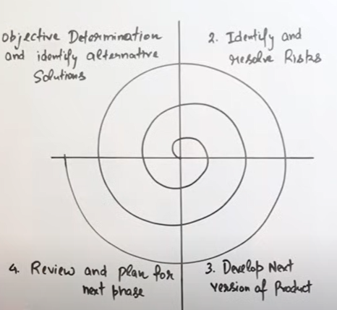

Slide 21
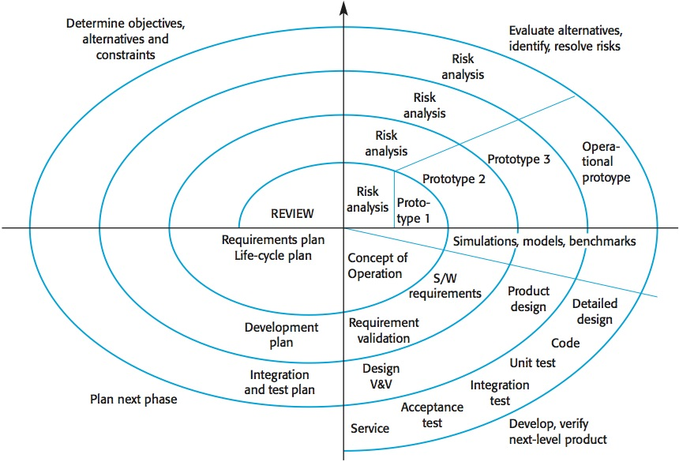
Cost
Progress

Slide 22
Spiral Model (Description)
Follows an evolutionary approach
Used when requirements are not well understood and risks are high
Inner spirals focus on identifying software requirements and project risks; may also incorporate prototyping
Outer spirals take on a classical waterfall approach after requirements have been defined, but permit iterative growth of the software
22

Slide 23
Operates as a risk-driven model…a go/no-go decision occurs after each complete spiral in order to react to risk determinations
Requires considerable expertise in risk assessment
Serves as a realistic model for large-scale software development

Slide 24
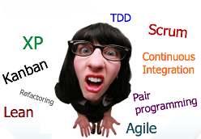
What is Agile

Slide 25
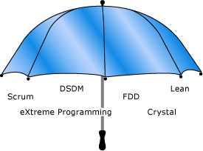
What is Agile

Slide 26
Agile Development

Slide 27
Rapid software development
Rapid development and delivery is now often the most important requirement for software systems
Businesses operate in a fast-changing requirement and it is practically impossible to produce a set of stable software requirements
Software has to evolve quickly to reflect changing business needs.
Plan-driven development is essential for some types of system but does not meet these business needs.
Agile development methods emerged in the late 1990s whose aim was to radically reduce the delivery time for working software systems

Slide 28
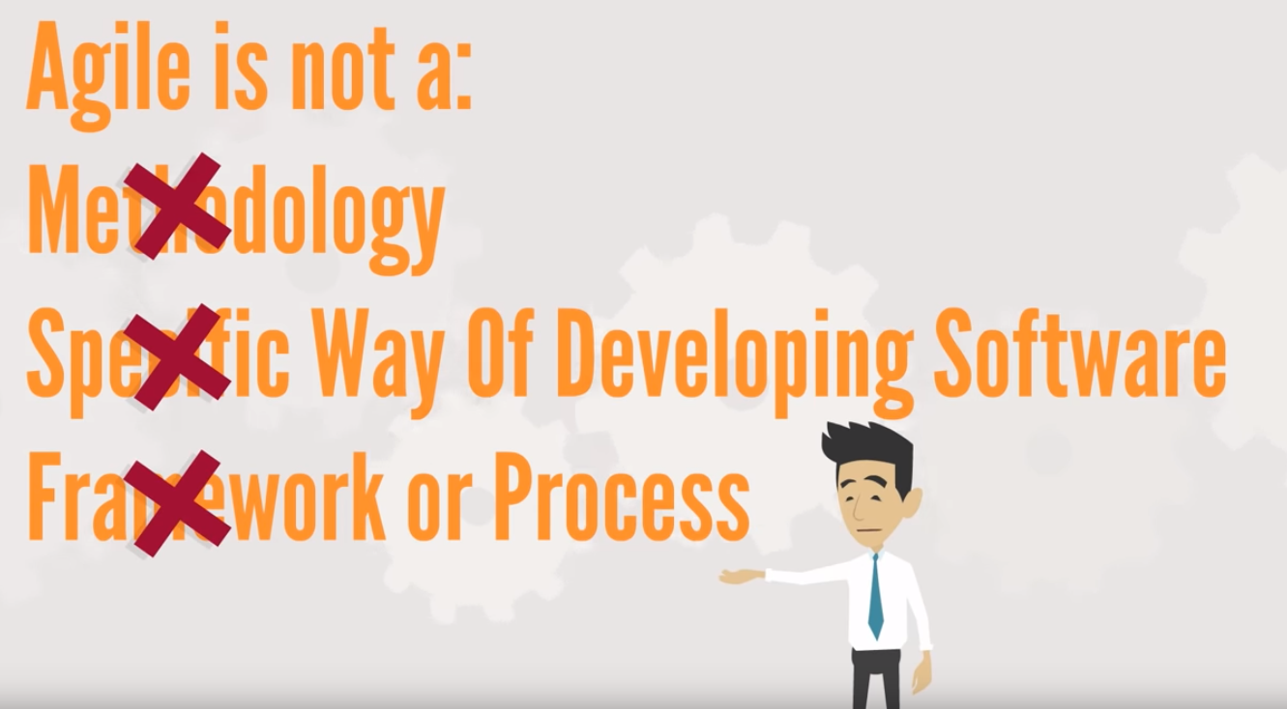

Slide 29
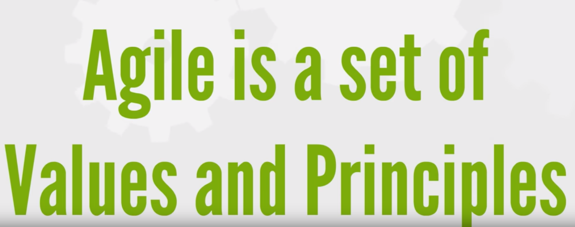

Slide 30
What agile is , it is surprisingly flexible
Agile doesn’t make decisions for you
Instead it gives a foundation for teams to make decisions that result in better software development

Slide 31
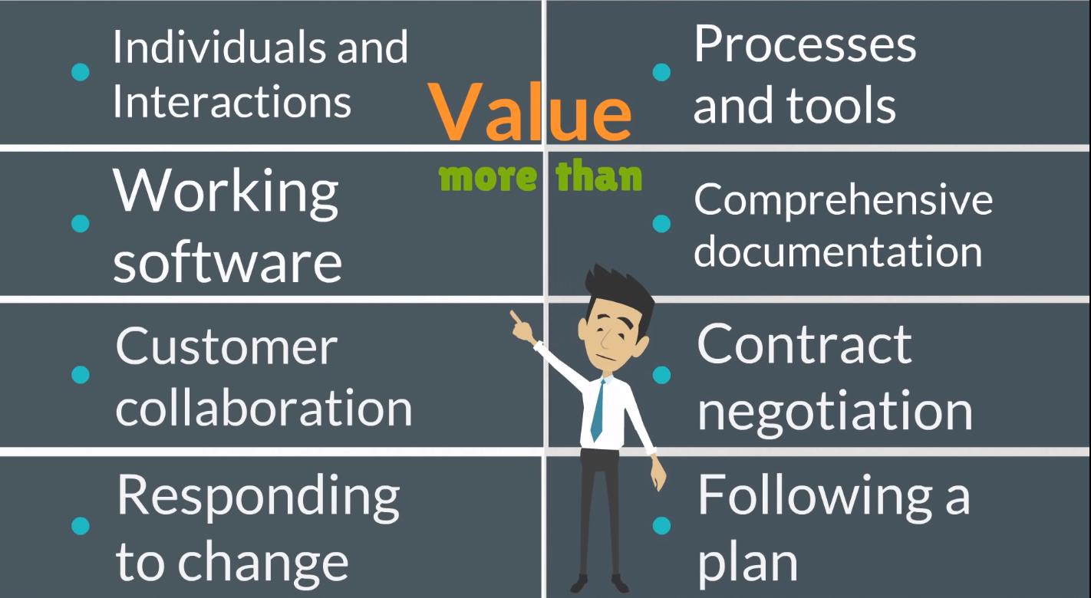
Agile Manifesto

Slide 32
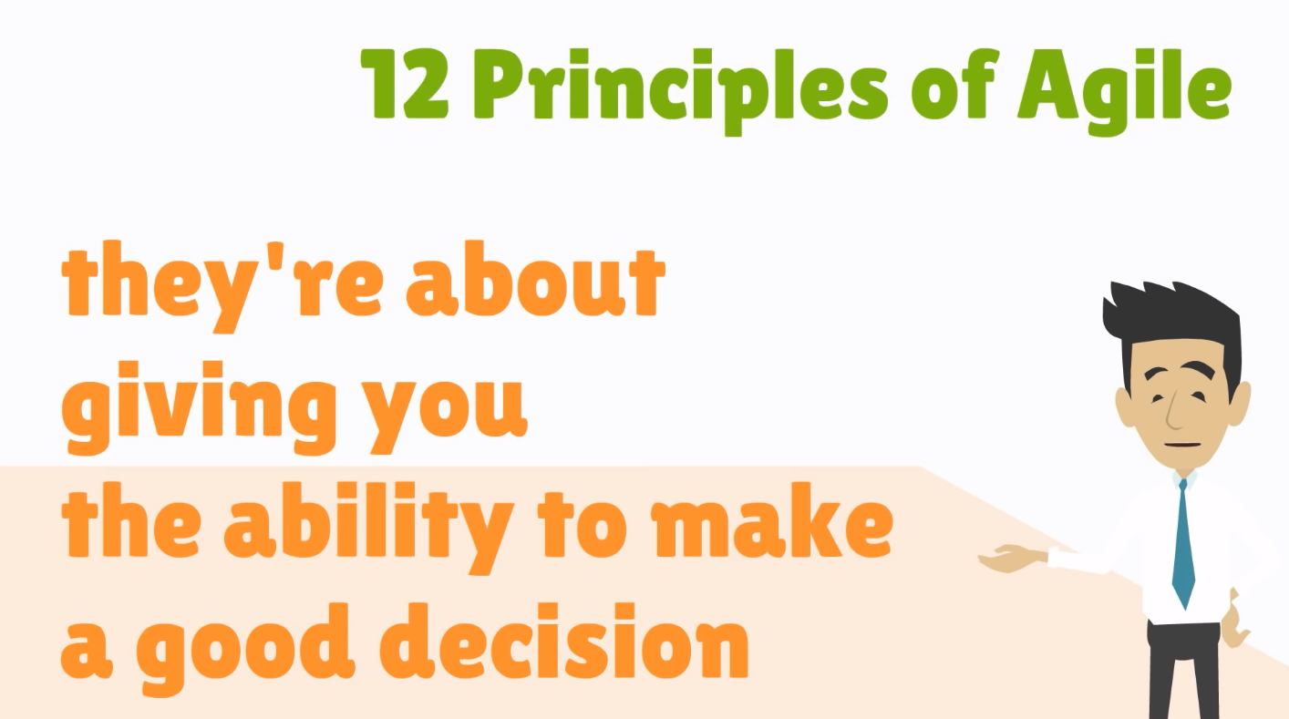

Slide 33
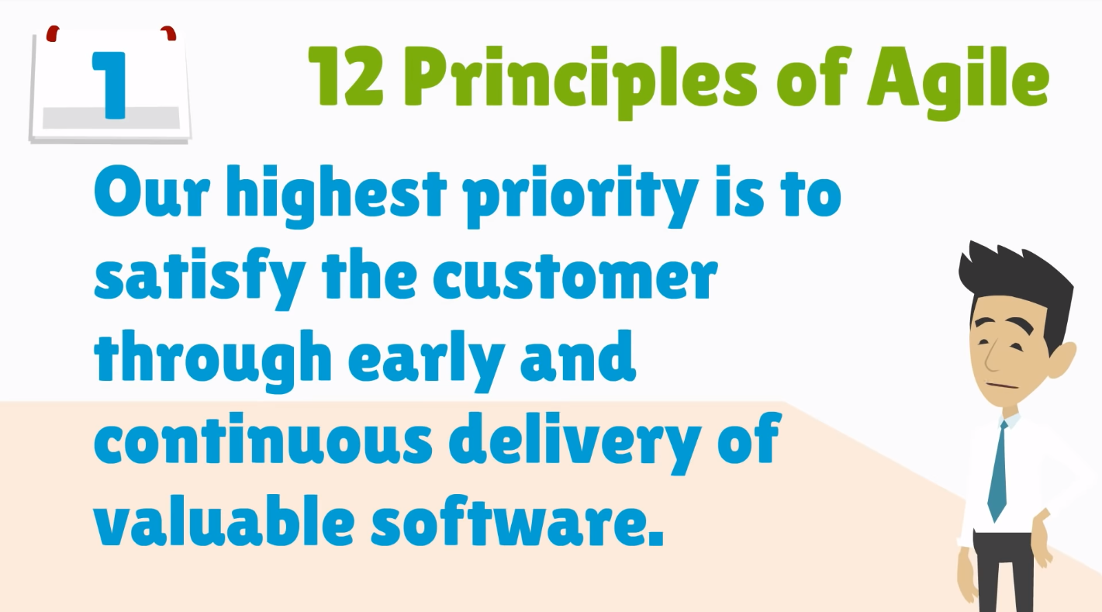
Notes:
Customer satisfaction – Deliver valuable software early and continuously.

Slide 34
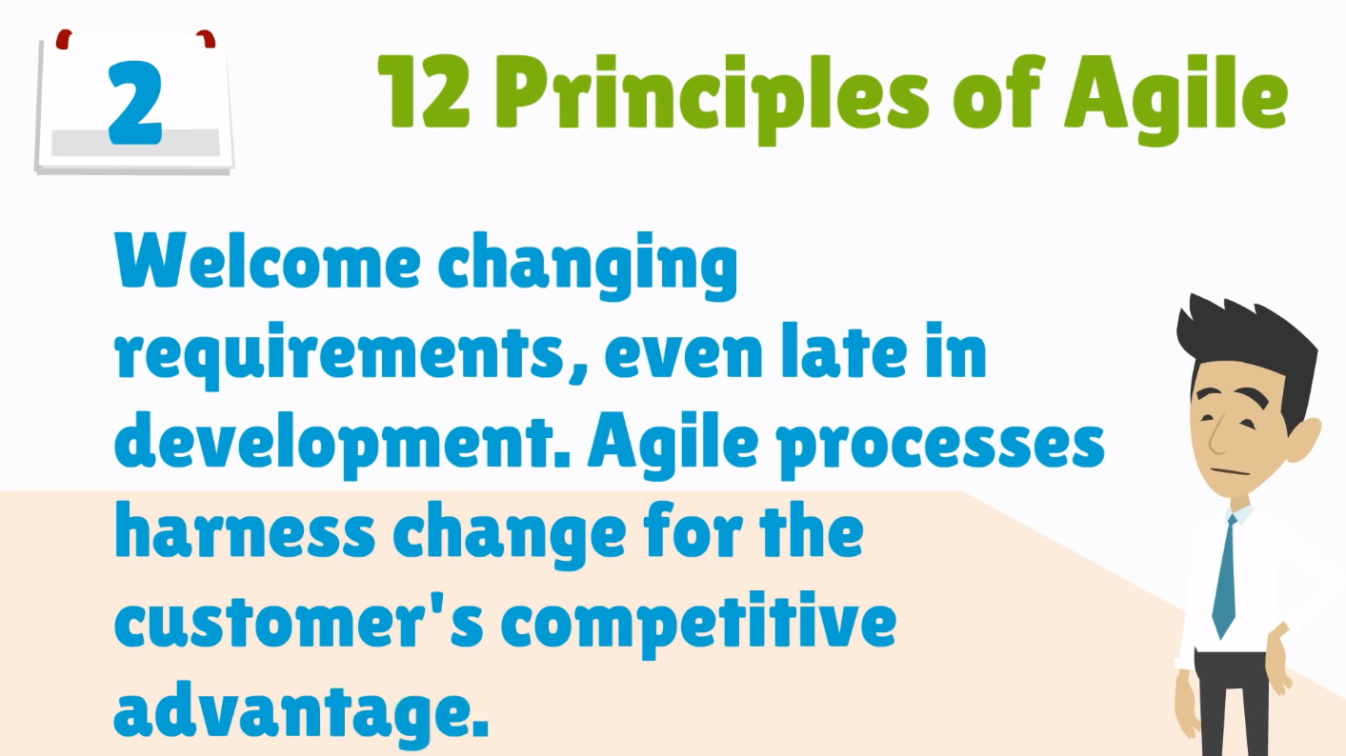
Notes:
Welcome change – Adapt to changing requirements at any stage.

Slide 35
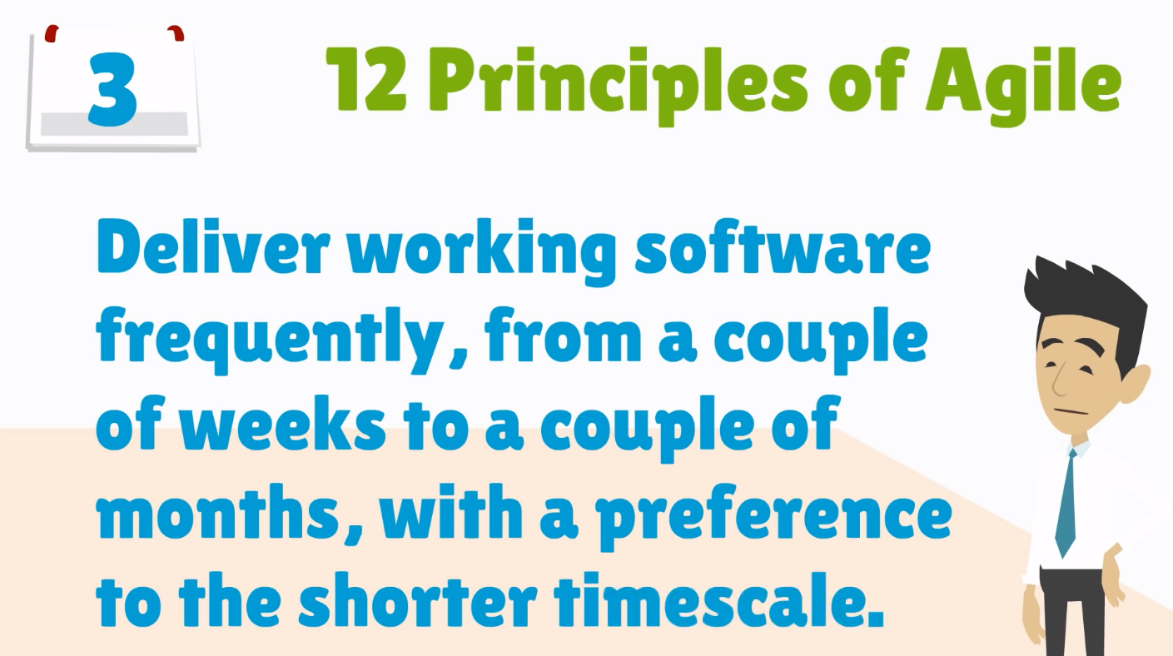
Notes:
Frequent delivery – Deliver working software in short iterations.

Slide 36
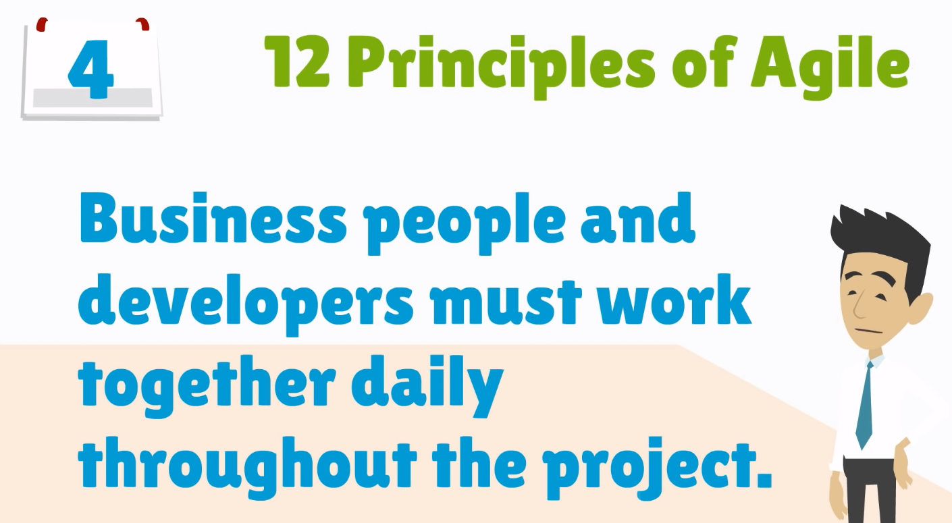
Notes:
Collaboration – Developers and business teams must work together.

Slide 37
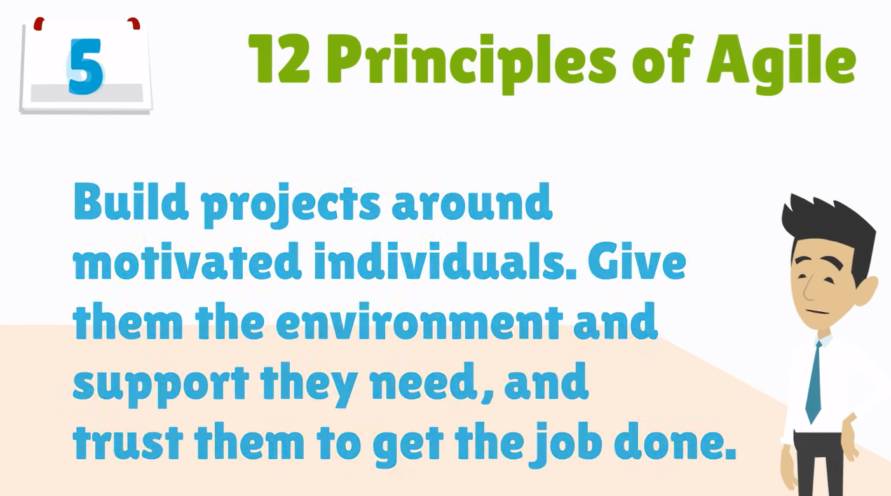
Notes:
Motivated individuals – Build projects with trusted and motivated teams.

Slide 38
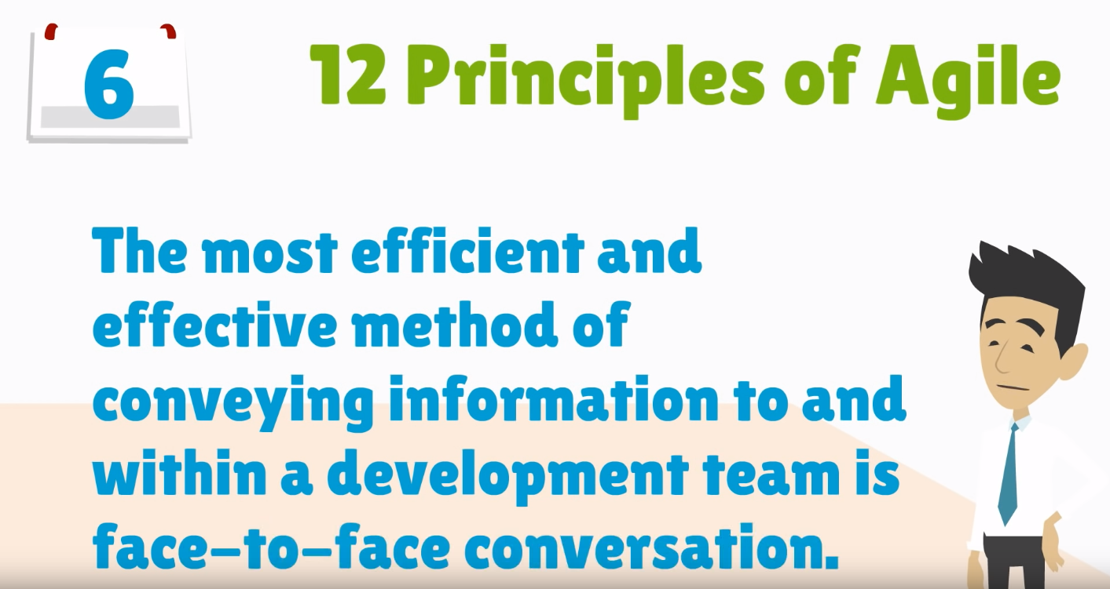
Notes:
Face-to-face communication – Direct interaction is the best form of communication.

Slide 39
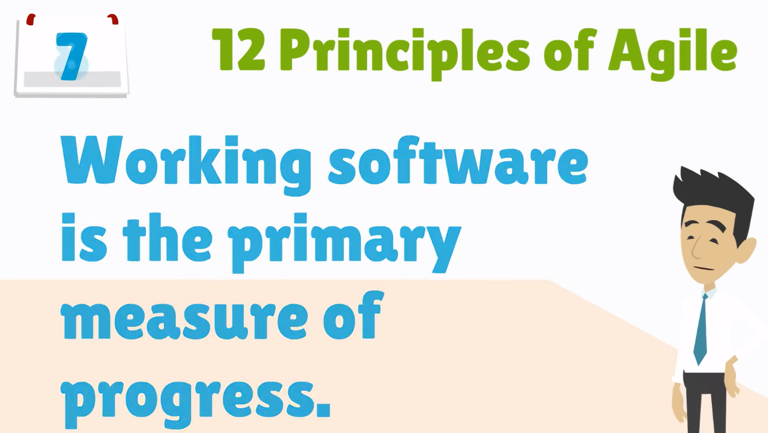
Notes:
Working software is the measure of progress – Focus on delivering functional software.

Slide 40
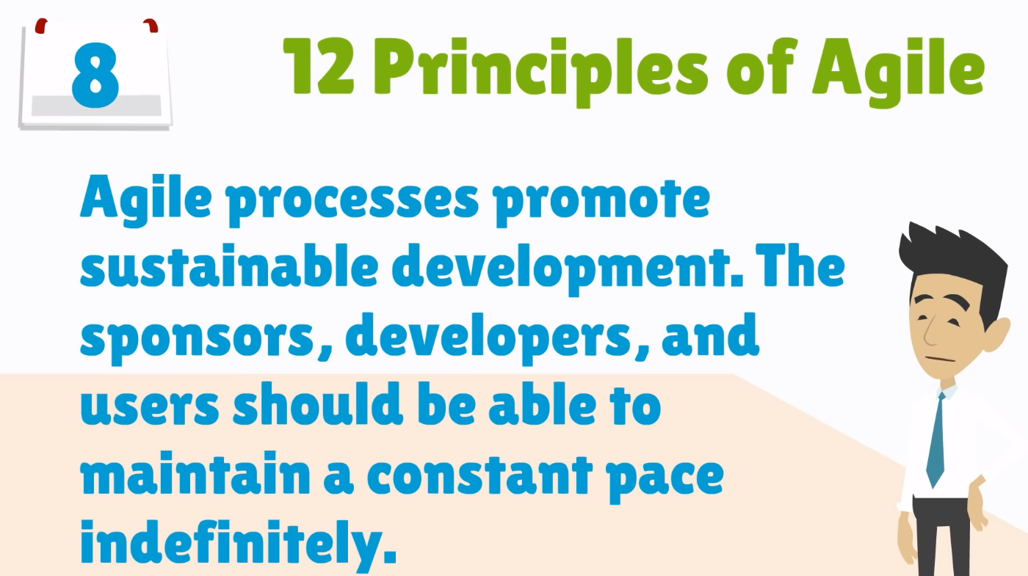
Notes:
Sustainable development – Maintain a constant pace for long-term success.

Slide 41
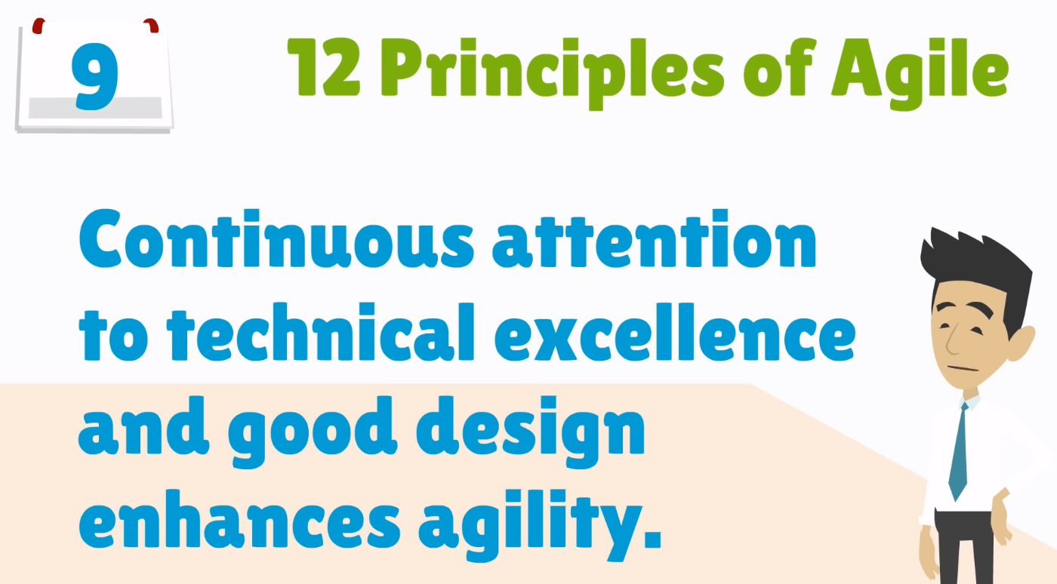
Notes:
Technical excellence – Prioritize good design and code quality.

Slide 42
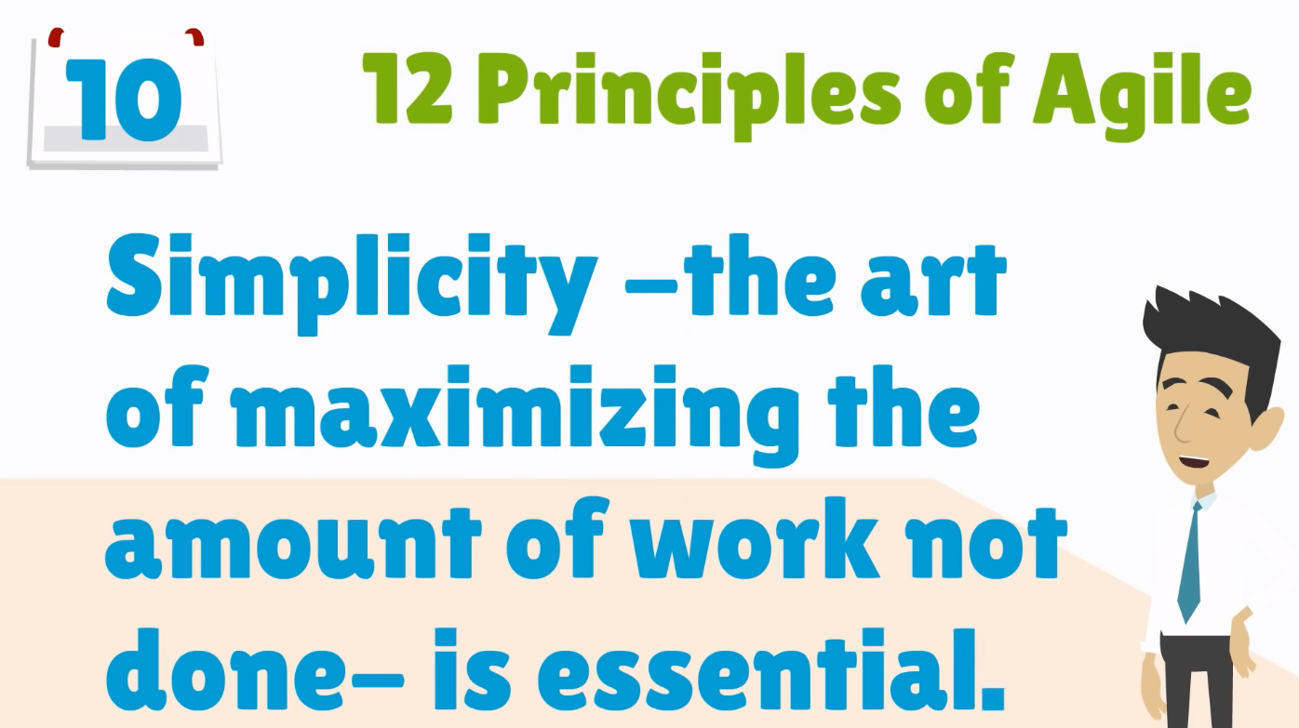
Notes:
Simplicity – Focus on minimal and efficient solutions.

Slide 43
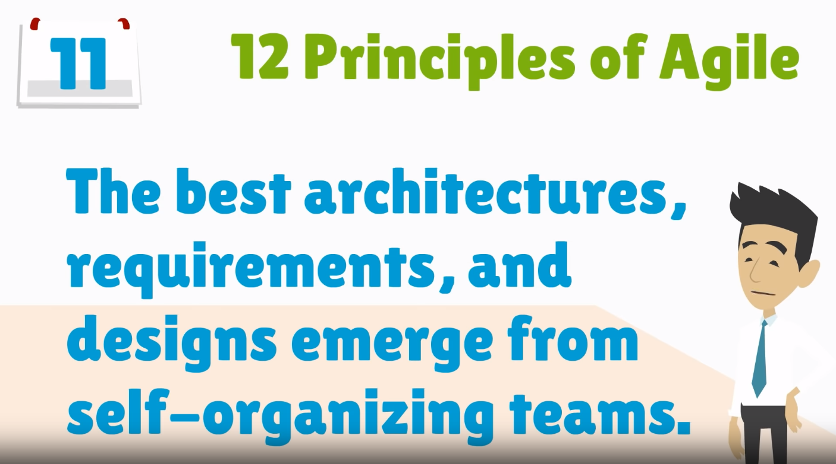
Notes:
Self-organizing teams – Empower teams to make decisions

Slide 44
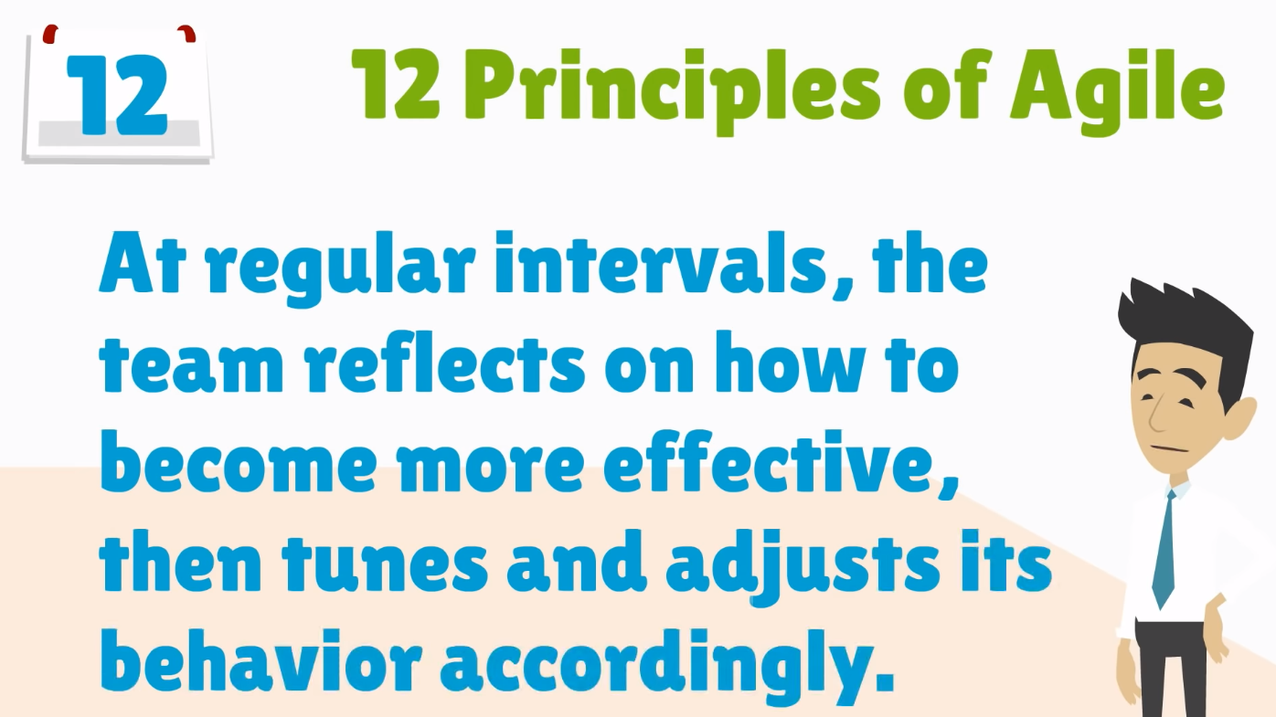
Notes:
Regular reflection – Teams should review and improve their processes.

Slide 45
What is “Agility”?
Effective (rapid and adaptive) response to change
Effective communication among all stakeholders
Drawing the customer onto the team
Organizing a team so that it is in control of the work performed
Yielding …
Rapid, incremental delivery of software

Slide 46
An Agile Process
Is driven by customer descriptions of what is required (scenarios)
Recognizes that plans are short-lived
Develops software iteratively with a heavy emphasis on construction activities
Delivers multiple ‘software increments’
Adapts as changes occur

Slide 47
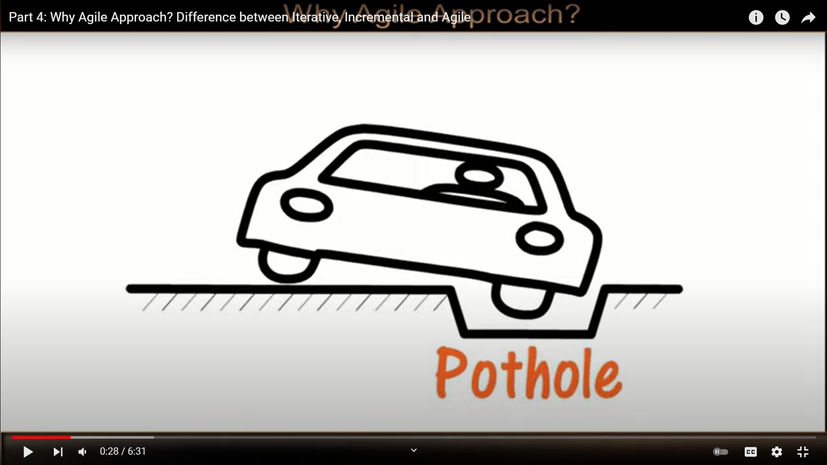
Problem
You have been assigned a project to fill this pothole. How you will solve the problem of filling the pothole using Waterfall mode, Iterative model, Incremental model and agile model?

Slide 48
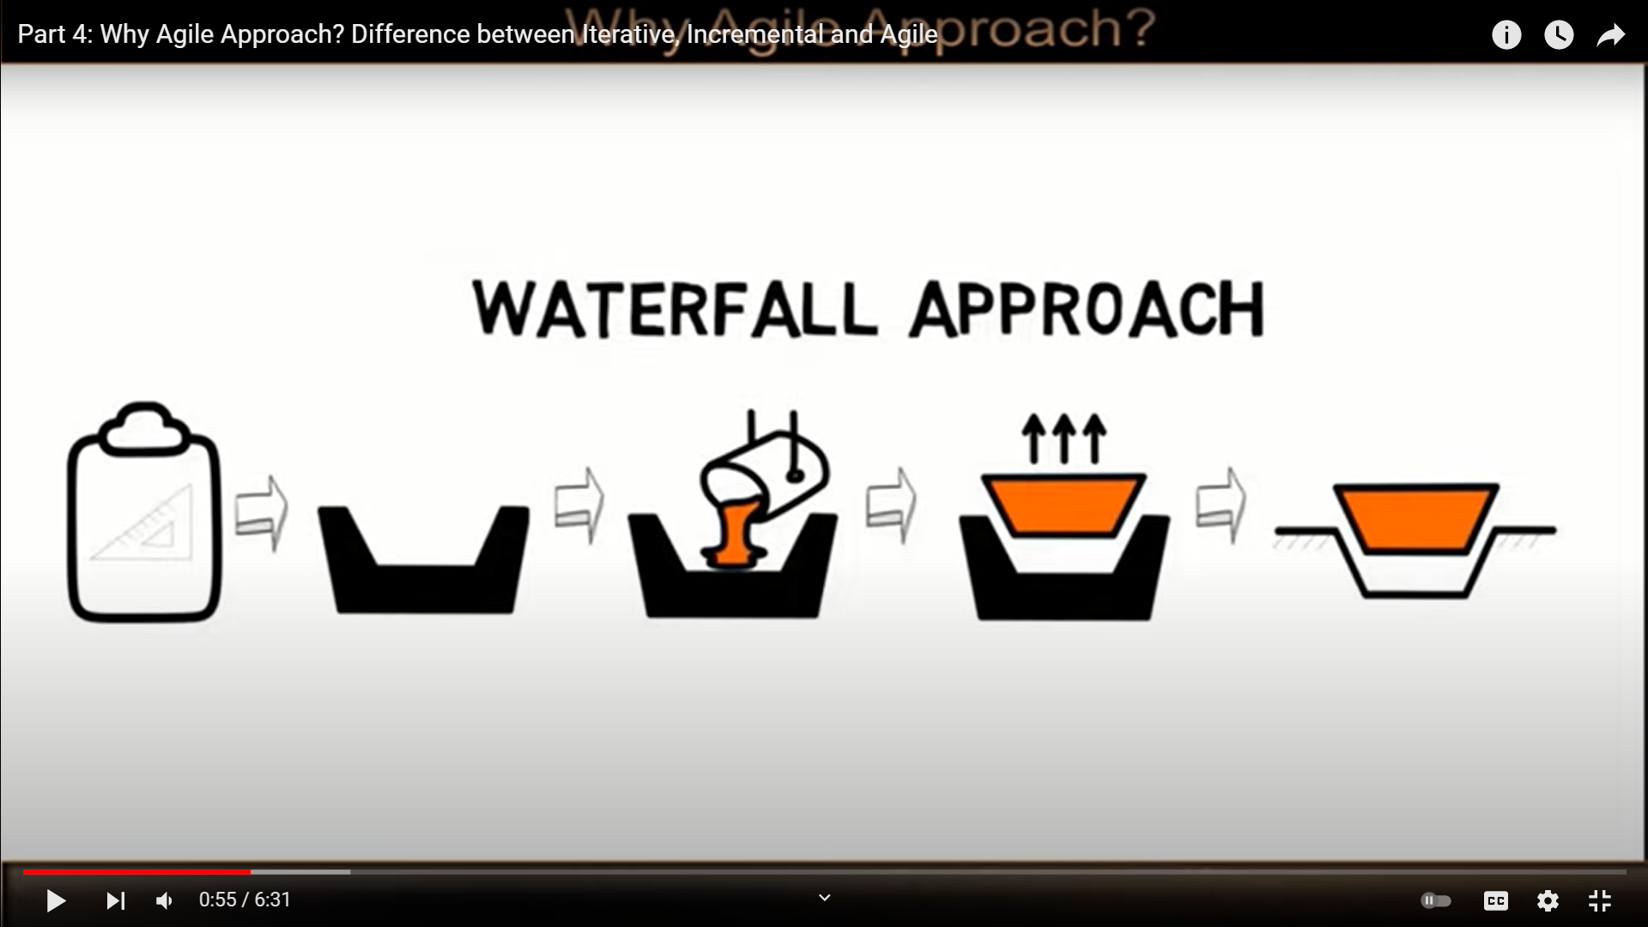

Slide 49
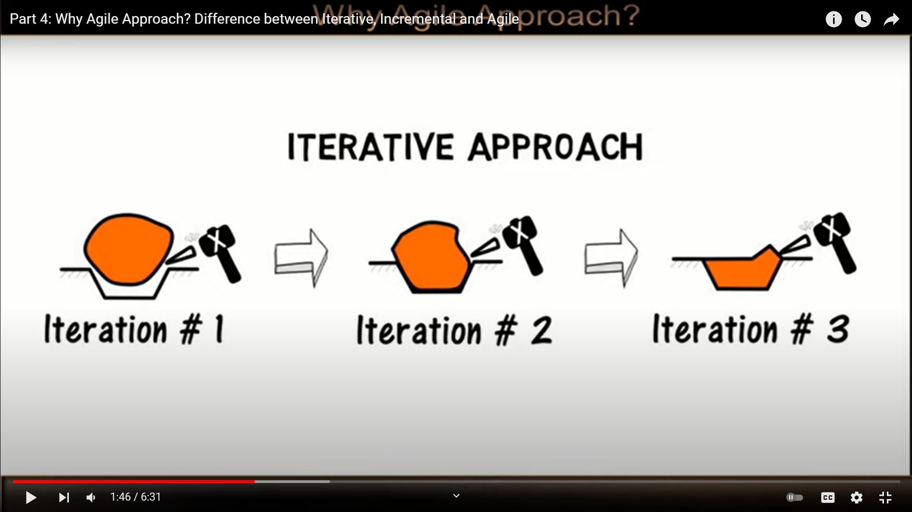

Slide 50
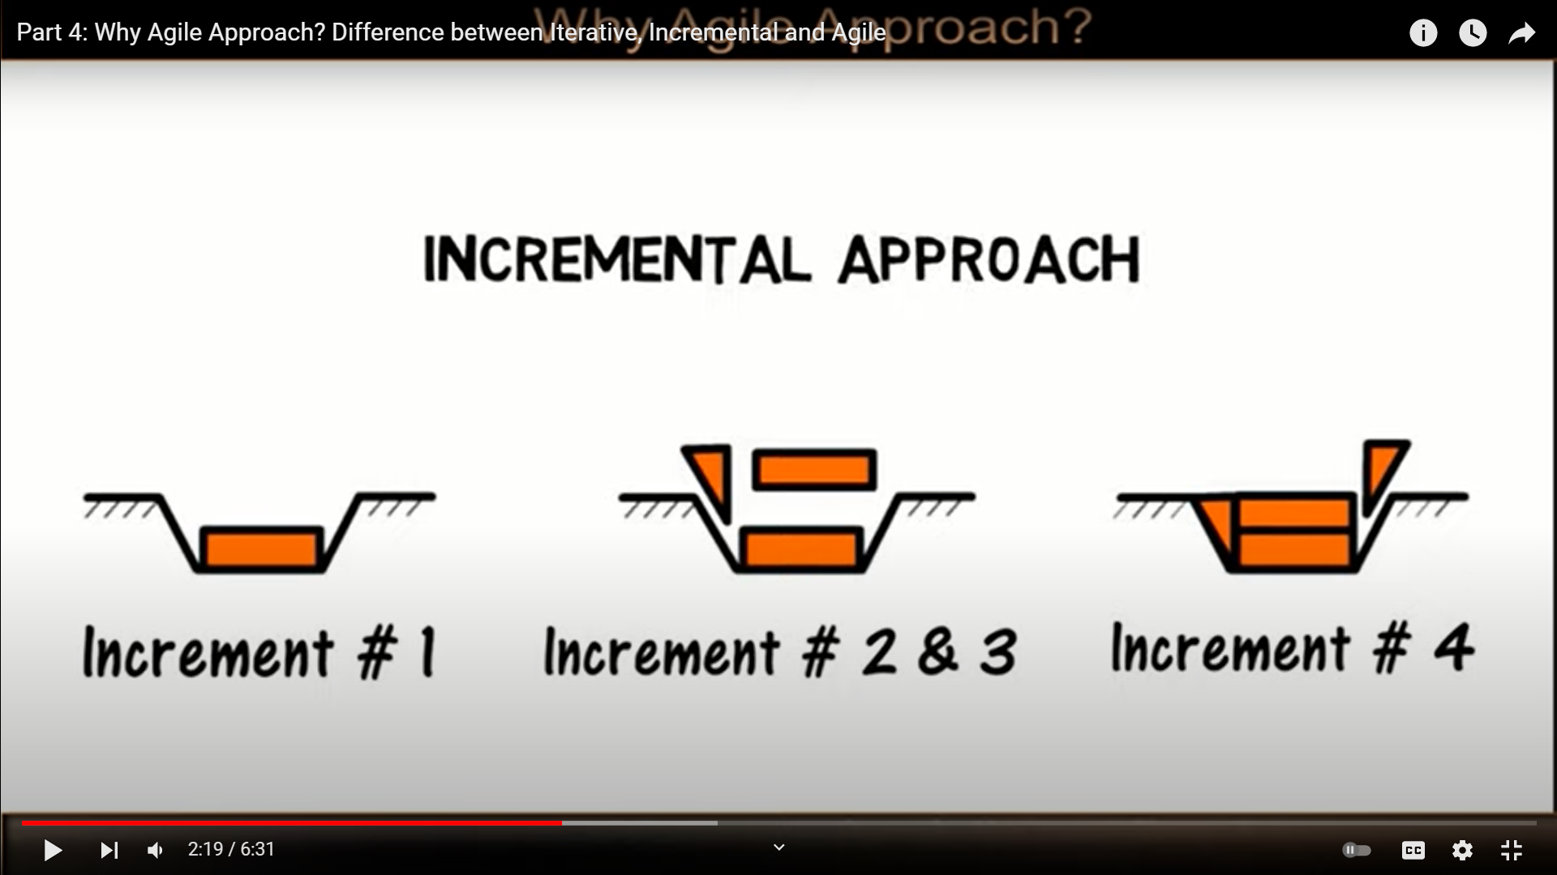

Slide 51
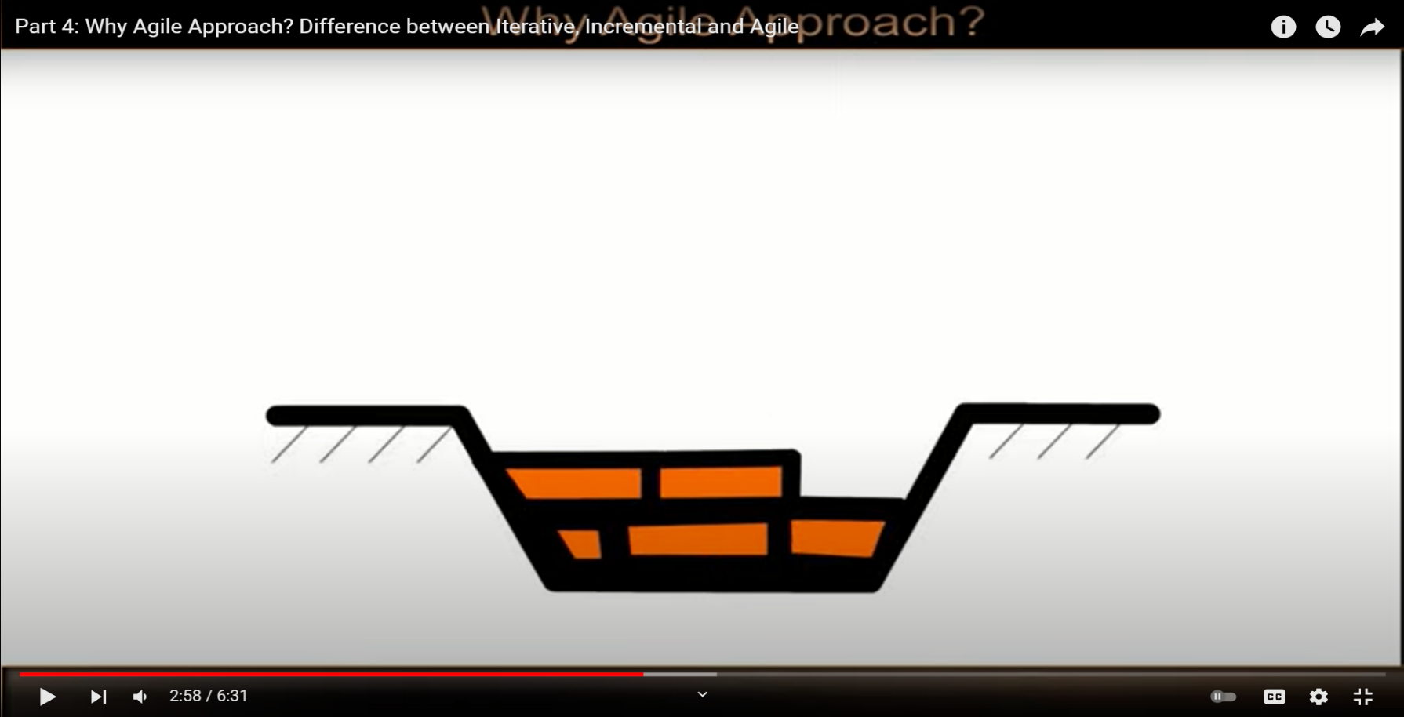
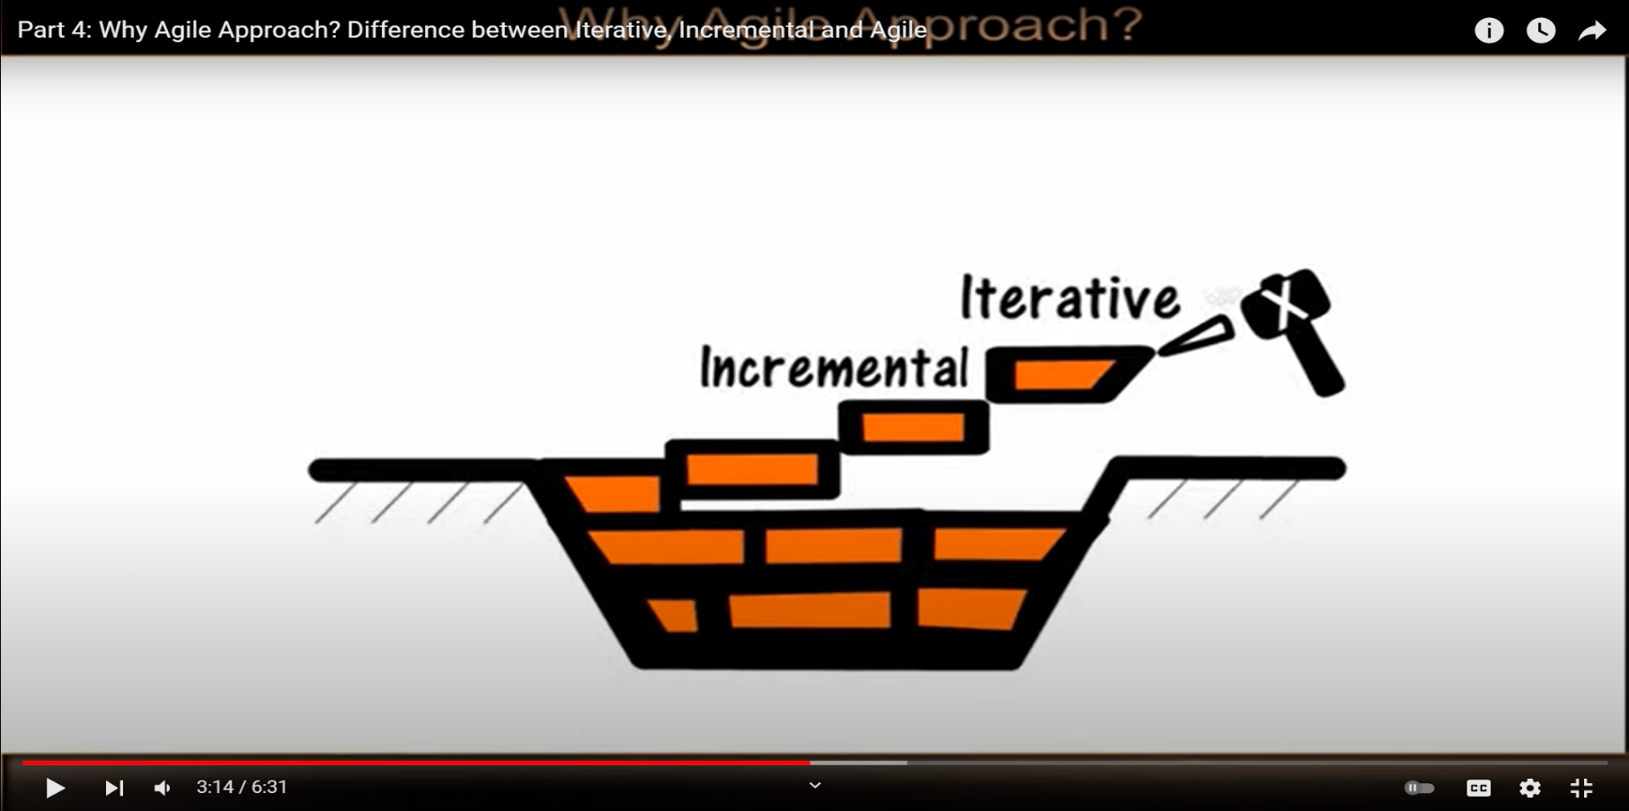
Agile approach

Slide 52
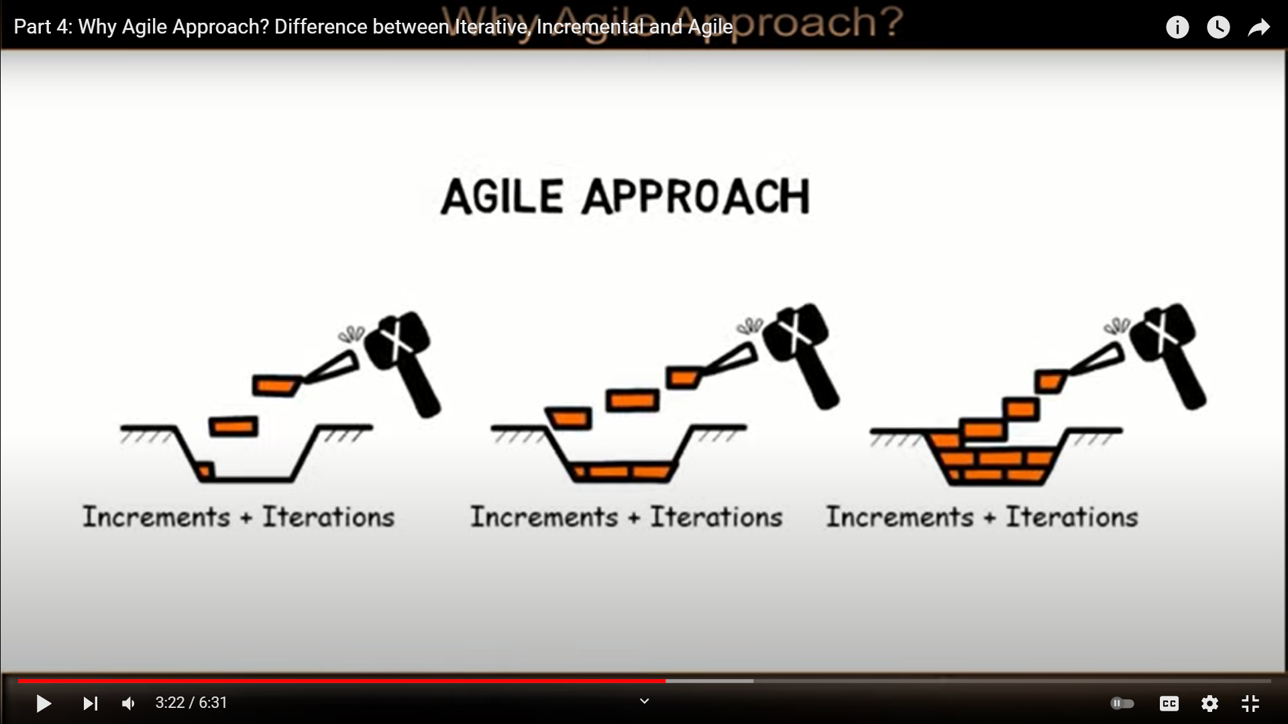

Slide 53
Agile process models
Extreme Programming (XP)
Scrum
Adaptive Software Development
Dynamic System Development Method (DSDM)
Crystal
Feature Driven Development
Agile Modeling (AM)
Notes:
The Agile Model is a flexible and iterative approach to software development. It focuses on continuous improvement, customer feedback, and delivering small, working software increments. Agile replaces traditional long development cycles with short iterations (called sprints), allowing teams to adapt to changing requirements.

Slide 54
Extreme Programming (XP)
Perhaps the best-known and most widely used agile method.
Extreme Programming (XP) takes an ‘extreme’ approach to iterative development.
New versions may be built several times per day;
Increments are delivered to customers every 2 weeks;
All tests must be run for every build and the build is only accepted if tests run successfully.
XP Values
Communication
Simplicity
Feedback
Courage
Respect

Slide 55
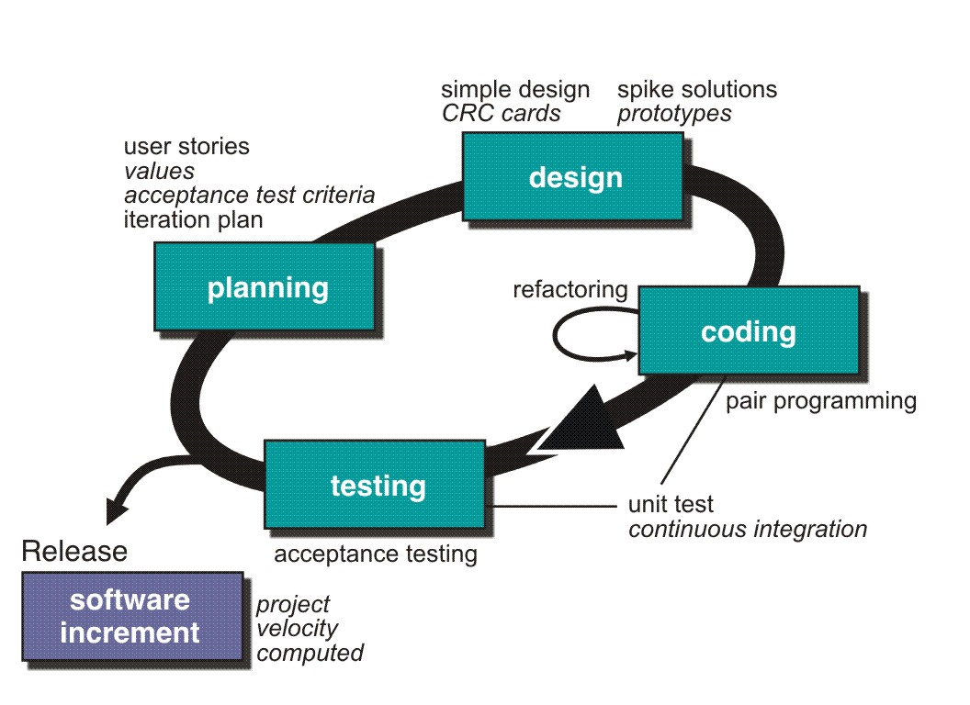
Extreme Programming (XP)
http://www.extremeprogramming.org/rules/spike.html

Slide 56
Extreme Programming (XP)
XP Planning
Begins with the creation of user stories
Agile team assesses each story and assigns a cost
Stories are grouped to for a deliverable increment
A commitment is made on delivery date
After the first increment project velocity is used to help define subsequent delivery dates for other increments

Slide 57
Extreme Programming (XP)
XP Design
Follows the (keep it simple) principle
Encourage the use of CRC (class-responsibility-cards) cards
For difficult design problems, suggests the creation of spike solutions — a design prototype
Encourages refactoring — an iterative refinement of the internal program design
XP Coding
Recommends the construction of a unit test for a story before coding commences
Encourages pair programming

Slide 58
Extreme Programming (XP)
XP Testing
All unit tests are executed daily
Acceptance tests are defined by the customer and executed to assess customer visible functionality

Slide 59
XP and agile principles
Incremental development is supported through small, frequent system releases.
Customer involvement means full-time customer engagement with the team.
People not process through pair programming, collective ownership and a process that avoids long working hours.
Change supported through regular system releases.
Maintaining simplicity through constant refactoring of code.

Slide 60
Customer involvement
Customer involvement is a key part of XP where the customer is part of the development team.
The role of the customer is:
To help develop stories that define the requirements
To help prioritize the features to be implemented in each release
To help develop acceptance tests which assess whether or not the system meets its requirements.

Slide 61
Requirements scenarios
In XP, user requirements are expressed as scenarios or user stories.
These are written on cards and the development team break them down into implementation tasks. These tasks are the basis of schedule and cost estimates.
The customer chooses the stories for inclusion in the next release based on their priorities and the schedule estimates.

Slide 62
Story card for document downloading

Slide 63
XP and change
Conventional wisdom in software engineering is to design for change. It is worth spending time and effort anticipating changes as this reduces costs later in the life cycle.
It proposes constant code improvement (refactoring) to make changes easier when they have to be implemented.

Slide 64
Refactoring
Refactoring is the process of code improvement where code is
re-organised and rewritten to make it more efficient, easier to understand, etc.
Refactoring is required because frequent releases mean that code is developed incrementally and therefore tends to become messy.
Refactoring should not change the functionality of the system.
Automated testing simplifies refactoring as you can see if the changed code still runs the tests successfully.

Slide 65
Testing in XP
Test-first development.
Incremental test development from scenarios.
User involvement in test development and validation.
Automated test harnesses are used to run all component tests each time that a new release is built.

Slide 66
Task cards for document downloading

Slide 67
Test case description

Slide 68
Test-first development
Writing tests before code clarifies the requirements to be implemented.
Tests are written as programs rather than data so that they can be executed automatically. The test includes a check that it has executed correctly.
All previous and new tests are automatically run when new functionality is added. Thus checking that the new functionality has not introduced errors.

Slide 69
Pair programming
In XP, programmers work in pairs, sitting together to develop code.
This helps develop common ownership of code and spreads knowledge across the team.
It serves as an informal review process as each line of code is looked at by more than 1 person.
It encourages refactoring as the whole team can benefit from this.
Measurements suggest that development productivity with pair programming is similar to that of two people working independently.

Slide 70
Problems with XP
Customer involvement
This is perhaps the most difficult problem. It may be difficult or impossible to find a customer who can represent all stakeholders and who can be taken off their normal work to become part of the XP team. For generic products, there is no ‘customer’ - the marketing team may not be typical of real customers.
Architectural design
The incremental style of development can mean that inappropriate architectural decisions are made at an early stage of the process.
Problems with these may not become clear until many features have been implemented and refactoring the architecture is very expensive.

Slide 71
Test complacency
It is easy for a team to believe that because it has many tests, the system is properly tested.
Because of the automated testing approach, there is a tendency to develop tests that are easy to automate rather than tests that are ‘good’ tests.

Slide 72
Key points
Extreme programming includes practices such as systematic testing, continuous improvement and customer involvement.
Customers are involved in developing requirements which are expressed as simple scenarios.
The approach to testing in XP is a particular strength where executable tests are developed before the code is written.
Key problems with XP include difficulties of getting representative customers and problems of architectural design.

